Slide 1

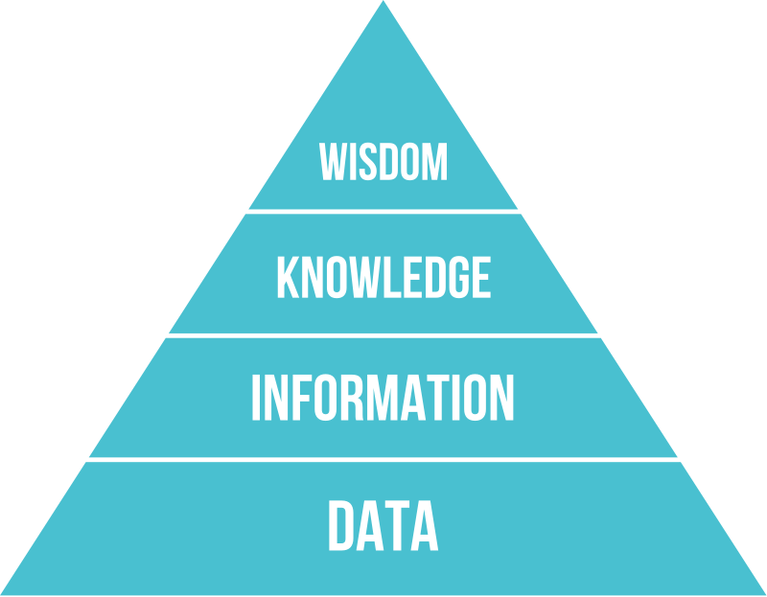
PYRAMID
Max Harris

Slide 2

MEANING
Knowledge is the ability to use information to form judgements and assessments
Information is data that has been processed with context and structure
Data is raw facts and figures that have not been processed
Wisdom is the ability to use knowledge and good judgement

Slide 3
DATA
Epic Games collects user data through account details you enter when you create an account to use the service.
They also use technologies such as cookies to collect different types of data on their website

Slide 4

INFORMATION
They use the data to verify and manage user accounts and features.
Developing their services
Personalising your experience
They share your information with console and

Slide 5
KNOWLEDGE
They store all your information, owned products, and friends in your personal account that is protected by username and password

Slide 6
WISDOM
They use your information to provide epic services such as Fortnite and Rocket League.
Epic services also provide the epic games store so you can download games that they offer you.

Slide 7
Thank you
Max Harris
Swindon

